Slide 1
Securing Mobile Ad-Hoc Networks
Nicholas petty • Maciej medyk

Slide 2
Agenda
MANET description
Networking protocol
Security vulnerabilities
Security requirements
Current protocol security measures
Case study
Conclusion
Sources
Questions

Slide 3
Manet description
Equal nodes that communicate over wireless links without any central control
Highly dynamic topology, expanding and contracting continuously
Deployed for a specific purpose and may be dismantled upon completion
Nodes are not physically secure and may be in motion
Networked devices have limited power
Network bandwidth must be conserved
Notes:
a. Equality means that malicious nodes are as valid as all other nodes.
b. No central control means that bad behavior is not prohibited and must be handled by the entire network.
c. Dynamic topology allows invaders.
d. Power drain and bandwidth drain are serious issues.
e. Because the networks are ad hoc, they are created with a single purpose, and any diminishing of network functionality could make the entire system a failure.
f. The features that make a MANET special, and more valuable in a given situation, compared to a normal wired network are also what makes it highly insecure.

Slide 4
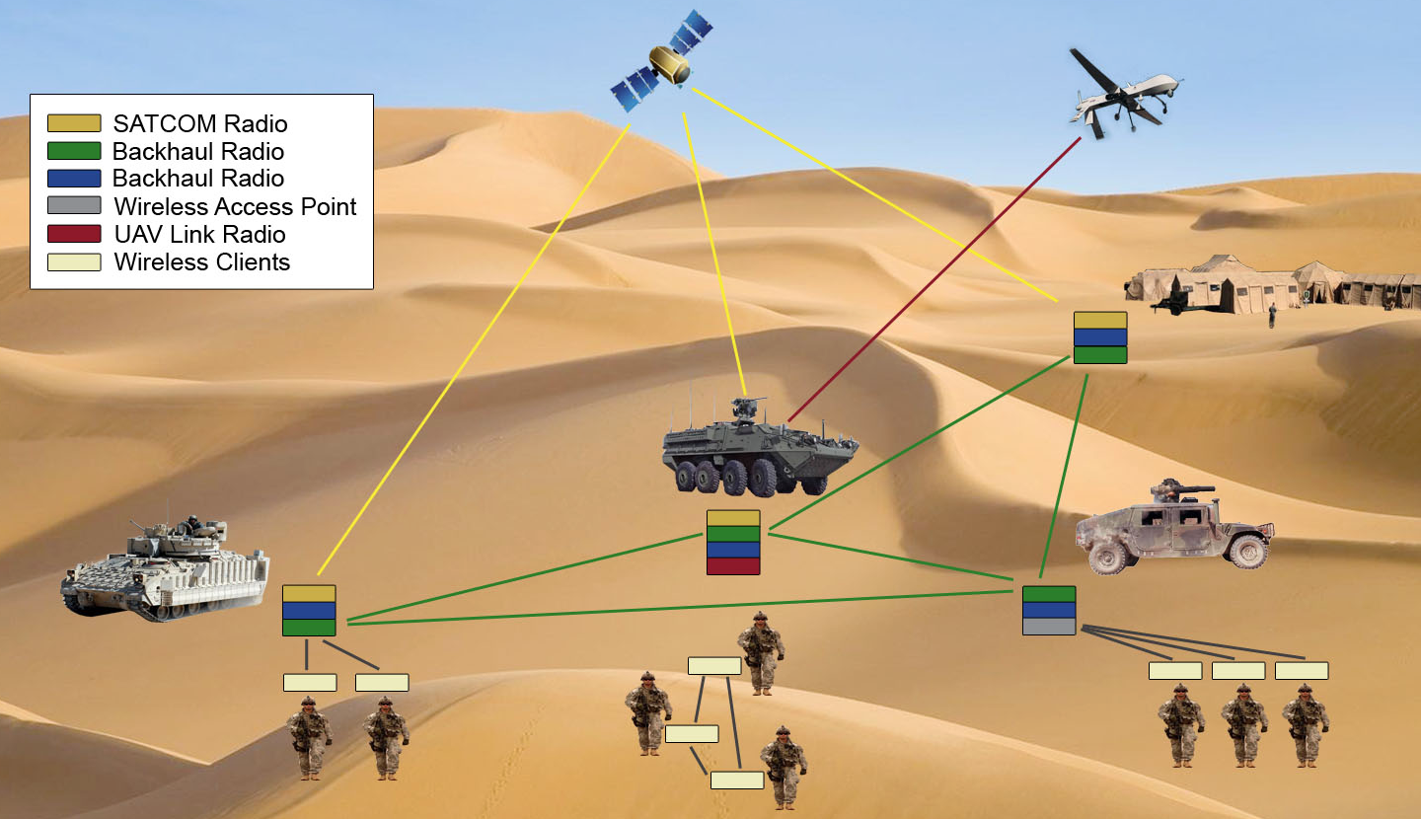
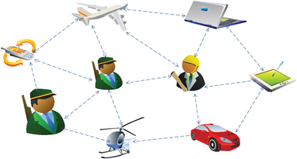
Manet examples
Tactical military communications
Wireless sensor networks
Smart phone ad hoc networks
Vehicular ad hoc networks
Notes:
a. Diagrams.
b. Body area networks, environment monitoring networks.
c. Android – Linux Wireless Extension, iOS – Multipeer Connectivity Framework, Bluetooth devices.
d. Vehicular Multi-technology Communication Device.

Slide 5
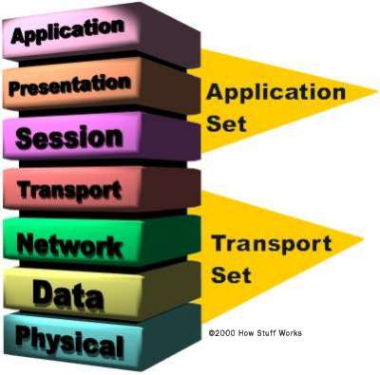
Networking protocol
Radio: Wi-Fi, Bluetooth, Cellular, Satellite
Open Systems Interconnection model (OSI model)
Wireless communication defined by IEEE 802.11 standard
Notes:
a. MANETs are primarily defined by their network infrastructure, so the application set is generally not the focus of these security systems.
b. Higher levels rely on cryptography and device-specific security.

Slide 6
Security vulnerabilities
Attacks and Denial of Service due to
No clear line of defense
Resource constraints
Dynamic network topology
Physical device access
Notes:
a. Again, the features that define MANETs also make them less secure than wired networks.
b. Attacks are defined as any events that diminish functionality of the network. They may be the result of an adversary, or more generally, environmental disruption, hardware malfunction, or software errors.
c. All attacks result in a denial of service – when the network does not perform its designed and required task. “Service” may be basic communication and message passing, or more complex, like efficiency and non-disclosure of secrets.

Slide 7
Physical layer attacks
Diminish network component functionality
Tampering – alter physical state of nodes
Jamming – overpower transmissions
Notes:
a. These attacks are simple, but often resource intensive.
b. Red nodes are jammed, yellow nodes are partially jammed and can report the jam boundary to the network, which can reroute. Jammed nodes can detect that they are jammed and shutdown until jam ends.

Slide 8
Data Link layer attacks
Logical Link Control / Media Access Control sublayers
Prevent reliable sending and receiving of messages, overuse error correction
Collision – multiple objects use layer simultaneously
Exhaustion (Interrogation) – repeated requests for media access
Unfairness – abuse cooperative scheme to drain resources
Notes:
a. Only a small portion of the transmission needs to be damaged to trigger retransmission, which requires a large resource expenditure.
b. Solutions: Error-correcting codes for collision repair, limit the rate of message responses, keep frames small.

Slide 9
Network layer attacks
Diminish network’s ability to direct traffic
Homing – target specific nodes for attack
Neglect and greed – drop or favor messages
Byzantine – create loops, misdirect packets
Black hole – advertise shortest routes
Wormhole – “tunnel” packets to create shorter routes
Spoofing – impersonate another node
Sybil – create multiple IDs for a single node
Notes:
a. Primary focus for security protocols to prevent these types of attacks.
b. Solutions: message redundancy, network probing, encryption to hide important nodes, authorization, monitoring, verification message source.
c. In a hierarchical structure, parents monitor and perform necessary security checks on children.
d. Watch network traffic, build a picture of structure for targets.
e. Black hole – simplest version is to advertise zero distance to all nodes. Wormhole – connect nodes by physical wire, modify message timestamps to appear faster.
f. Byzantine – one or more nodes, destroying routing.

Slide 10
Transport layer attacks
Destabilize connections between nodes
Flooding – excessively request connections
Desynchronization – alter control portions of messages
Notes:
a. Another major layer for security protocols.
b. Solutions: puzzles – clients must solve a puzzle, thus commit resources, before a connection is established, authentication – prevent falsified messages that break connections.

Slide 11
routing protocol Attacks
Routing Table Poisoning – modify routing table or route update packets
Route Cache Poisoning – node route caches are poisoned in on-demand protocols
Packet Replication – resend stale packets
Rushing Attack – attacker quickly floods route requests
Notes:
a. Focus is the routes established by the network, make the routes sub-optimal, prevent new routes from being established, diminish service in sections of the network, or direct traffic through target nodes.
b. Route table poisoning – fake or modified update messages.
c. Packet replication – consumes resources to invalidate packets.
d. Route cache poisoning – again, fake or modified update messages
e. Rushing attack – on-demand protocols without duplicate suppression are vulnerable. Multiple messages are sent out at once, causing other nodes to ignore legitimate requests as duplicates. The malicious node can insert itself into any routes discovered.

Slide 12
Security requirements
Secure networks provide confidentiality, authentication, integrity, non-repudiation, and access control
Protection from internal and external threats
Low resource cost
Scale across network sizes and bandwidths
Adapt to normal network errors
Available to all components, all the time

Slide 13
SECURITY Methods
Physical Layer Security – FHSS and DSS
Data Link Layer Security – ERA-802.11
Network Layer Security – Digital Signature, MAC, HMAC
Black Hole Attack Security - SAR
Impersonation Attack Security - ARAN
Modification Attack Security - SEAD
Transport Layer Defense – SSL, TLS, PCT
Notes:
Physical Layer Security – FHSS and DSS – Frequency Hopping Spread Spectrum is a method of transmitting radio signals by rapidly switching a carrier among many frequency channels using pseudorandom sequence known to both transmitter and receiver. Direct Sequence Spread Spectrum is a technique whereby the original data signal is multiplied with pseudo random noise spreading code. Spreading code has higher chip rate which results in wideband time continuous scrambled signal.
• Data Link Layer Security – ERA-802.11 – ERA-802.11 protocol is used for detection of selfishness. In event of nodes misbehavior report is sent to an external reputation management system. ERA-802.11 introduces extra messages and is not compatible with the 802.11 standard. Additionally traffic analysis is prevented by encryption of data link layer. That can be achieved via traffic cover mode and dynamic mix mode which hides source and destination information during message delivery via a cryptography method.
• Network Layer Security – Digital Signature, MAC, HMAC – Digital signature is based on asymmetric key cryptography, MAC is Message Authentication Code, and HMAC Hashed Message Authentication Code which is based on nodes sharing a secret symmetric key k which they can efficiently generate and verify a message authenticator using one way hash function.
• Black Hole Attack Security – SAR –Secure Aware Ad Hoc Routing protocol which defines a level of trust as a metric for routing and as an attribute for security for routing. Security Aware Routing protocol using Ad-Hoc on Demand Distance Vector protocol uses encryption and decryption process using a common key. The main drawback with SAR protocol is whenever the levels of security rise; it needs different keys for different levels, thereby increasing the number of keys.
• Impersonation Attack Security – ARAN – Authenticated Routing for Ad Hoc Networks is a security protocol based on cryptographic certificates which overcomes all types of attacks in the network layer. Three major properties of cryptography, authentication, integrity and non-repudiation are supported with both Dynamic Source Routing and Ad-Hoc on Demand Distance Vector protocols. ARAN provides authentication and non-repudiation services using predetermined cryptographic certificates for end-to-end authentication. Each hop verifies the signature of the previous hop and replaces it with its own.
• Modification Attack Security – SEAD – Secure Efficient Ad Hoc Distance Vector Routing protocol is mainly designed for DSDV (Destination Sequenced Distance Vector). This protocol can overcome Denial of Service, all types of routing attacks and resource consumption attacks. It uses one way hash function without the usage of asymmetric cryptographic mechanism. The mechanism uses authentication to differentiate between malicious and non-malicious nodes, which in turn reduces resource consumption attacks launched by malicious nodes. Because different hash function is used for different i and j used, the attacker can never forge lower metric value, or greater sequence value.
• Transport Layer Defense – SSL, TLS, PCT – Secure Socket Layer is standard security technology for establishing an encrypted link between server and client. Transport Layer Security is a protocol that ensures privacy between communicating application and their users on the internet. TLS ensures that no third party may eavesdrop or tamper with any message. Private Communication Technology was a protocol designed to address security flaws in initial SSL protocol. PCT has been superseded by TLS and SSL3.

Slide 14
Trust in ad-hoc network
Trust and Key Management
Trusted Third Party
Web of Trust
Localized Trust
Notes:
• Trust and Key Management – Trust and Key Management is critical supporting element of any security system. Its basic operations include establishing trust and secret connection as well as key exchange and update. Keys use both symmetric and asymmetric cryptographic functions for authentication, confidentiality, and integrity.
• Trusted Third Party – a certification authority that is trusted by every entity and all nodes that were deemed trustworthy by that centralized authority are trusted by every node in the network. The scheme is centrally managed; however, neighborhood of central point is a bottle neck for a scalable network and subject to DOS attacks. The system employs threshold cryptography to distribute n shares of private key to key management service amount the server nodes in secure way while public key is known to all members of the network.
• Web of Trust – no particular structure exists and each entity manages its own trust based on direct recommendation from others. The scheme is fully distributed making it resilient to attacks; however, it’s difficult to achieve consensus between nodes. System is built on top of direct communication through secure side channels. Direct point to point contact works only when two nodes are within secure range of each other and being able to exchange information and credentials. Nodes that have established security associations via direct contact also trust other nodes with whom other nodes established same level of security.
• Localized Trust – this model is a middle ground between trusted third party and web of trust. Node that is trusted among other nodes if enough nodes agree and that nodes becomes a certification authority for the other local nodes. The localized trust share refresh mechanism that protects the private key of service by updating all shares periodically. The localized traffic pattern of security service provisioning minimizes its impact on network scalability and performance concerns and meanwhile maximizes security service’s availability.

Slide 15
Cryptographic methods of authentication
HMAC – hash message authentication code
Digital Signature – asymmetric key cryptography
One-Way HMAC key chain – lightweight one way authenticator
Notes:
HMAC – hash message authentication code – two nodes share a secret symmetric key and can efficiently generate and verify a message authenticator using a cryptographic one-way hash function. The computation is efficient and affordable by low-end devices such as small sensor nodes. HMAC can be verified by only the intended receiver. Secure Routing Protocol is used to distribute pairwise shared keys.
• Digital Signature – asymmetric key cryptography – Digital Signature is based on asymmetric key which involves more computation overhead for signing, decrypting, verifying, and encrypting operations. It is less DOS resilient because an attacker may feed a victim node with a large number of bogus signatures to exhaust the victim’s computation resource for verifying them. Each node also needs to keep a Certificate Revocation List of the revoked certificates.
• One-Way HMAC key chain –The computation involved in one-way key chain based authentication is lightweight and one authenticator can be verified by large numbers of receivers. However, these benefits come with certain costs. First, hash-chain-based authentication requires clock synchronization at granularities that may need special hardware support. Second, receivers need to buffer a message to verify them when the key is revealed. The delay in the verification of routing messages may greatly decrease the responsiveness of the routing protocol. Third, the release of the key involves a second round of communication. The timer has to be carefully gauged according to the specific context. Finally, the storage of the hash chain is nontrivial for long chains, as required in the scenarios with large rekeying intervals.

Slide 16


Secure AD-Hoc routing
Source Routing
Distance Vector Routing
Link State Routing
Notes:
Source Routing – Source Routing Protocols such as Dynamic Source Routing main challenge is to ensure that each intermediate node cannot remove existing nodes from or add extra nodes to the route. The basic technique is to attach a per hop authenticator for the source routing forwarder list so that any altering of the list can be immediately detected.
• Distance Vector Routing – Distance Vector Based Routing protocols such as Destination Sequenced Distance Vector Routing and Ad-Hoc on Demand Vector protocol main challenge is that each intermediate node has to advertise the routing metric correctly. When hop count is used as the routing metric, each node has to increase the hop count by one exactly. Hop count hash chain is devised so that an intermediate node cannot decrease the hop count in a routing update. Note that hash chain for this purpose does not need time synchronization, which is different from one-way HMAC key chain for authentication.
• Link State Routing – Secure Link State Routing is a link state routing protocol for ad hoc networks. Its operations are similar to Internet link state routing protocols like Open Shortest Path First where each node seeks to understand its neighborhood by Neighbor Lookup Protocol and periodically floods Link State Update packets to propagate link state information.

Slide 17
Protecting packet forwarding
Localized Detection
ACK-Based Detection
Global Reaction
End-Host Reaction
Notes:
Localized Detection – Proposes Watchdog to monitor packet forwarding on top of source routing protocols like DSR. It assumes symmetric bidirectional connectivity. Because the whole path is specified, when node forwards a packet to the next hop, it knows following next hop. It then overhears the channel for transmission and if it does not hear the transmission after a time-out, a failure tally associated with node is increased. If the tally exceeds a threshold bandwidth, source sends a report packet to the source notifying other nodes misbehavior.
• ACK-Based Detection – Fault detection mechanism proposed is based on explicit acknowledgments. The destination sends back ACKs to the source for each successfully received packet. The source can initiate a fault detection process on a suspicious path that has recently dropped more packets than an acceptable threshold. It performs a binary search between itself and the destination and sends out data packets piggybacked with a list of intermediate nodes, also called probes, which should send back ACKs.
• Global Reaction – Reaction scheme falls into the global reaction category. It is based on the ubiquitous and robust access control framework. Once multiple nodes in a local neighborhood have reached the consensus that one of their neighbors is malicious, they collectively revoke the certificate of the malicious node.
• End-Host Reaction – Path Rater allows each node to maintain its own rating for every other node that it knows about. A node slowly increases the rating of well-behaving nodes over time, but dramatically decreases the rating of a malicious node that is detected by its Watchdog. Based on the rating, the source always picks up a path with highest average rating.

Slide 18

Intrusion detection systems
Watchdog and Path Rater
TWOACK
Enhanced Adaptive ACKnowledgement (EAACK) protocol
Notes:
Watchdog and Path Rater – Watchdog and Path Rater are to main components that try to improve performance of Ad-Hoc networks in presence of disruptive nodes. Watchdogs determines behavior by copying packets to be forwarded into a buffer and monitoring the behavior of the adjacent nodes of these packets. Watchdog snoops to decide if the adjacent node forwards the packets without modification. The number of violation is compared to a predetermined threshold before the node is marked as suspicious. Path Rater on individual node works to rate all of the known nodes in particular network with respect to their reliabilities. Ratings are made and updated from particular node perspective.
• TWOACK – Two Network Layer Acknowledgment based protocol which detects misbehaving nodes and seeks to alleviate the problem by notifying routing protocol to avoid them in the future routes. The protocol monitors source, intermediate, and destination nodes and keeps the counter that this incremented after each packet transmission and monitors the node for transmission time and accuracy of transmission. If transmission time is longer than expected node is marked as misbehaving and if transmission differs from original packet then confidentiality is lost.
Enhanced Adaptive ACKnowledgement (EAACK) protocol – EAACK is based on TWOACK scheme and it has an acknowledgment based network layer scheme which can be used as a combination of TWOACK and End to End acknowledgment scheme called ACK. Compared to TWOACK this protocol considerably reduces network overhead while still capable of maintaining and even surpassing the same network throughput during data transmission. The end to end transmission sends a packet without overhead except for a flag indicating packet type. In this network all intermediate nodes simply forward this packet to next nodes. When destination node receives the packet it sends back an acknowledgment packet to the sender down the reverse order of the same route. That’s how accuracy of the packet transmission is determined.

Slide 19
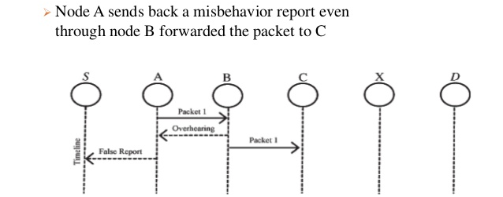
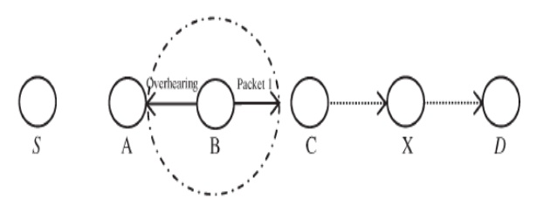
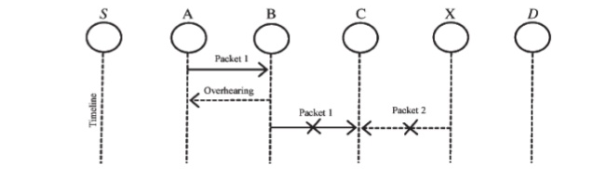
Problems with Watchdog
False Misbehavior Limited Transmission Power
Receiver Collision
Notes:
• False Misbehavior – Malicious node intentionally claims that other nodes are malicious and misbehaving. If node A is malicious then it will claim that node B is malicious and misbehaving even if is not.
• Limited Transmission Power – If node A overhears that node B has sent data but node C did not receive it and if node B can adjust transmission power then it may drop data between and prove to be malicious.
• Receiver Collision – Consider a case in which node B sends data to C which isn’t received. In such case A may overhear that B forwarded the data but it cannot tell wherever it was received or not.

Slide 20
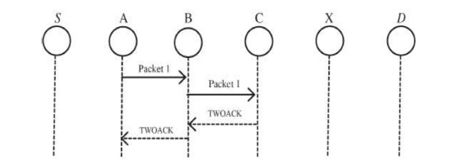
twoack
Better than watchdog as it solves receiver collision and limited power problems
Overhead heavy

Slide 21
Eaack – Enhanced Adaptive Acknowledgement
Solves all three problems described in Watchdog method
Three major parts
ACK – End to End Acknowledgement scheme
S-ACK – Secure ACK – Improved version of TWOACK where three consecutive nodes work in a group to detect misbehavior
MRA- Misbehavior Report Authentication – Detects misbehaving nodes with the presence of false misbehavior report

Slide 22
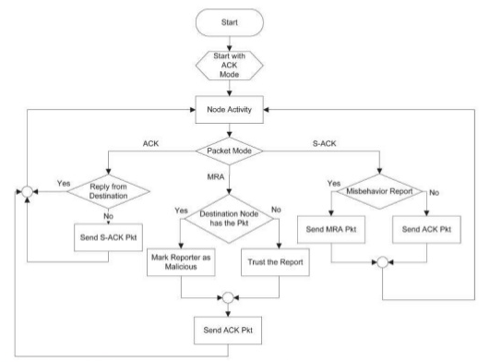
EAACK DIAGRAM

Slide 23

EAACK simulation

Slide 24

Case study
FireChat by Open Garden
Mobile ad hoc social network
Links mobile devices with app via Internet, cellular, WiFi, or Bluetooth
Mesh network with end-to-end encryption
iOS uses Apple’s Multi-peer Connectivity Framework, Android is proprietary
Security problems: physical attacks, eavesdropping in public channels, no authentication
Made famous during Taiwan’s Umbrella Protests
Notes:
a. Can share Internet connection among crowds.
b. private rooms and channels are established locally during events.
c. Particularly useful when there is a lot of interference, strain on the existing infrastructure, or the threat of oppression.

Slide 25
conclusion
What did we learn?
What problems do we see?
What solutions do we agree/disagree with?
What is the likely direction of security considerations in MANETs?
Notes:
a. Security is not just passwords; network functionality must be maintained.
b. Many uses for MANETs are not possible because of security risks. MANETs are not always designed with security systems in place.
c. Security protocols are publicly available and open to scrutiny. Security methods should be open, only keys should be kept private.
d. More work is needed on the physical side. Devices need to be engineered to be damage-resistant, have long battery life, and strong connection capabilities.

Slide 26
sources
Ilyas, Mohammad, and Imad Mahgoub. Mobile Computing Handbook. Boca Raton: Auerbach Publications, 2005. Print.
Li, Wenjia, and Anupam Joshi. "Security Issues in Mobile Ad Hoc Networks- A Survey." CiteSeerX, n.d. Web. 25 Mar. 2016.
Mahgoub, Imad. "Introduction to Mobile Computing." Florida Atlantic University. Lecture.
Michiardi, Pietro, and Refik Molva. "AD HOC Networks Security."Basagni/Ad Hoc Networking Mobile Ad Hoc Networking (2005): 329-54. Web.
Stojmenović, Ivan. Handbook of Wireless Networks and Mobile Computing. New York: Wiley, 2002. Print.
Tanwar, Sarvesh, and Prema K.V. "Threats & Security Issues in Ad Hoc Network: A Survey Report." International Journal of Soft Computing and Engineering (IJSCE) 2.6 (2013): n. pag. Web.
Tyson, Gareth. "Mesh Networks and Firechat Make 'switching off the Internet' That Much Harder." Phys.Org. N.p., 7 Oct. 2014. Web. 01 Apr. 2016. <http://phys.org/news/2014-10-mesh-networks-firechat-internet-harder.html>.
Tyson, Jeff. "How OSI Works." HowStuffWorks. N.p., n.d. Web. 25 Mar. 2016. <http://computer.howstuffworks.com/osi1.htm>.
Wood, A.D., and J.A. Stankovic. "Denial of Service in Sensor Networks."Computer 35.10 (2002): 54-62. Web.

Slide 27
sources
O'Rourke, Chris. "COTS Journal." Mobile Ad Hoc Networking Revamps Military Communications -. N.p., Nov. 2011. Web. 03 Apr. 2016. <http://www.cotsjournalonline.com/articles/view/102158>.
Patterson, Stephen Max. "Android Phones Are Connecting without Carrier Networks." Network World. N.p., 12 Feb. 2013. Web. 03 Apr. 2016. <http://www.networkworld.com/article/2224025/smartphones/android-phones-are-connecting-without-carrier-networks.html>.
McGarry, Caitlin. "How FireChat Is Using an Obscure IOS Feature to Change Messaging." PCWorld. N.p., 31 Mar. 2014. Web. 03 Apr. 2016. <http://www.pcworld.com/article/2137265/how-firechat-is-using-an-obscure-ios-feature-to-change-messaging.html>.

Slide 28
Questions and answers
Thank you for your time.

